Slide 1
Isotopes of levitated particle rafts
Tchakamau Ra

Slide 2
Why study this?
Precedent with mixture of materials
Studies done on particles in colloids show that material properties matter
Arrangement mechanisms in ordinary clusters
Material properties
Glass, polystyrene have different densities, different speeds of sound

Slide 3
What are we studying?
What particles / materials\what forces – depletion forces
What motions – instability from detuning kcks partcles, athermally
Why isotopes?

Slide 4
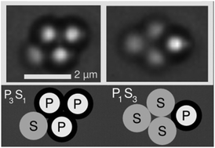
What are the three shapes, and bonds?

Slide 5
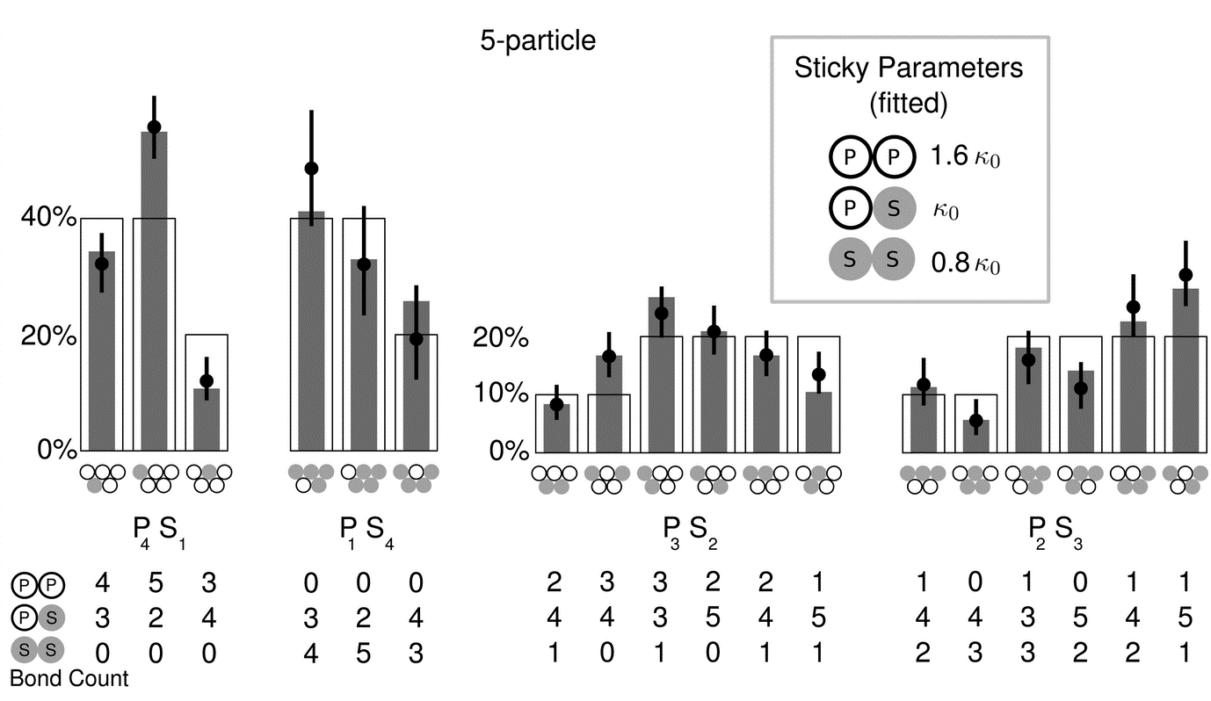
Why we think there’ll be a difference -this, and we saw one ourselves in the first data
Material properties of the spheres affect the probability of forming each raft arrangement

Slide 6
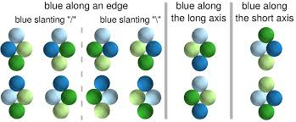
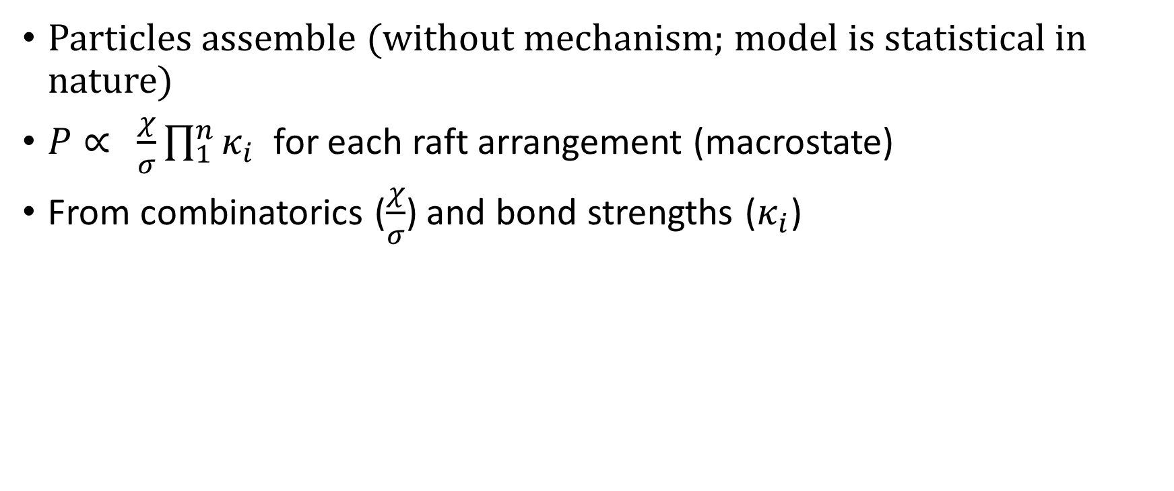
What goes into determining the proabbilities? (From previous experientatl fit)?
Particles assemble (without mechanism; model is statistical in nature)
$P∝ \frac{χ}{σ}\prod_{1}^{n}{κ_{i}}$ for each raft arrangement (macrostate)
From combinatorics ($\frac{χ}{σ}$) and bond strengths ($κ_{i}$)

Slide 7
Note: two different scattering regimes, two different mechanisms of motion
And both of them are ergodic
And I am not using bond angles in any way – approach angles, I mean

Slide 8
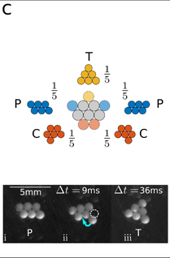
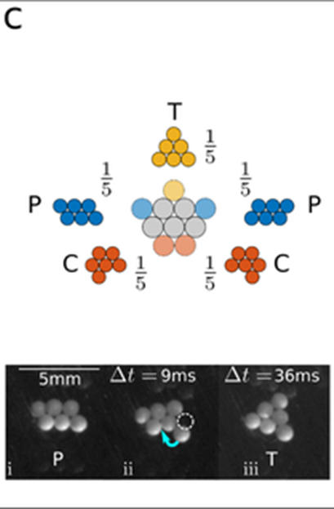
Motions
Hinge
Show pobs: / show transititon matrix percs
Break apart
Show pobs: / show transititon matrix percs

Slide 9
Markov modeling
Create a transition matrix from observed data
Observe how many transitions to and from each state (should be equal)
And note ratios
Create model transition matrices
Dependent on proposed methods of rearrangement for the particles
Include, in some mechanisms, dependence on bond strength
Compare

Slide 10
What assumptions go into model, that might be broken?
I’m in the non-sticky, ergodic regime
All of the states are equally likely, barring the combinarotical ad stickiness weightings
So there’s no history, that is, when you reach a stae, it doesn’t dictate which ststae you go to next (by kepign you ther / after one move)
And the markov matrix has detailed balance, that is, it’s symmetric, that is, it’s as likely to enter a state from another as to leave the state for the other
All of mine are ergodic assumptions, maybe trghats the problem, because the states aren’t equally likely because rthey have history.

Slide 11
Making predictions
Models
Edge particles move, can go one space left or right
Same, but can go back to old spot
Same, but can go to any spot
Can go to any spot, but only left particle moves
End state just proportional to #bonds * bond strengths

Slide 12
Experiment 1
With styrene and polyethylene, can you get the transitions to skew from predicted for equal bodn strength
And if it skews ,can you explain it?
All surfaces washed, and discharged aeveyr now and then by touching the slide.

Slide 13
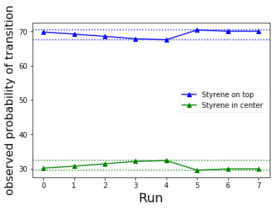
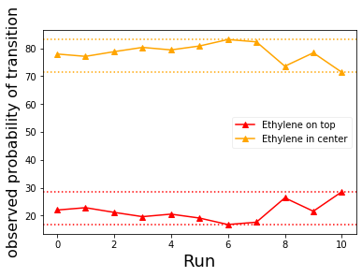
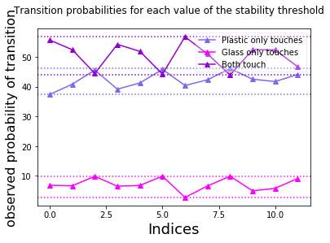
Results 1
The mixed bonding is preferred, no matter how many of each particle I have

Slide 14
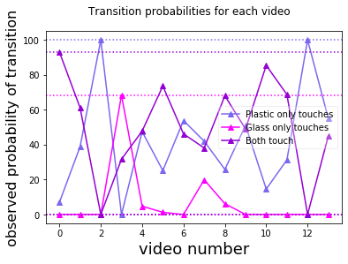
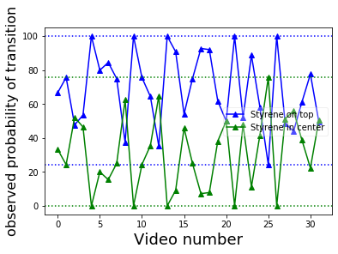
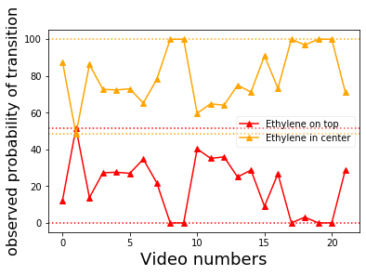
Results 1
There’s some periodicity in the proportions from video to video. I combined two datasets, each of which was mostly taken in one or two sittings. It looks like the proportions move towards styrene being in the venter (3 ethylene, 1 styrene), or ethylene being on top (1 ethylene, 3 styrene), so over time the styrene-ethylene bond or styyerene-styrene bonds become more favoure, then reset and do that again.
Show three graphs of overlapping data and experiments

Slide 15
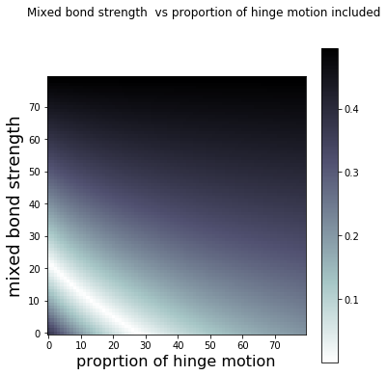
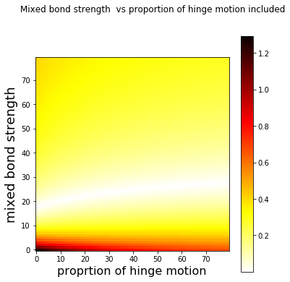
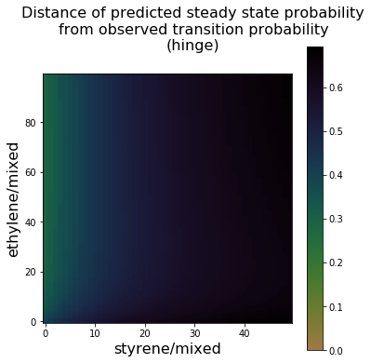
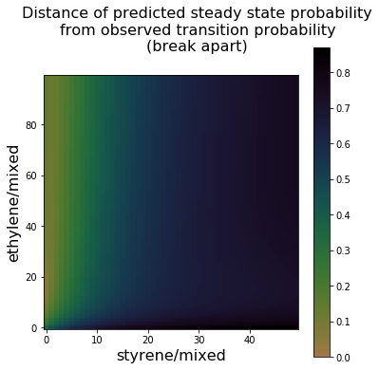
Results 1
The predicted bond strengths are so and so
The runs show some combination of hinging and breaking apart (video evidence), and the models can fit the data with up to []% hinge motion (3 styrene case), and []% (3 ethylene case).
Show one diagram each, with the slash, giving possible bond strength values for plastic/mixed and styrene/mmixed, and the overlap diagram from the

Slide 16
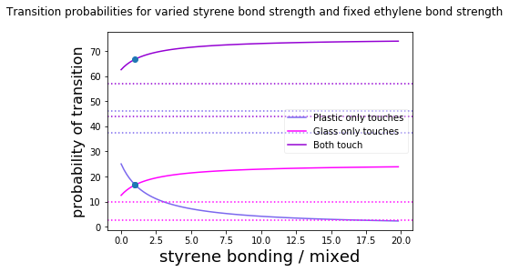
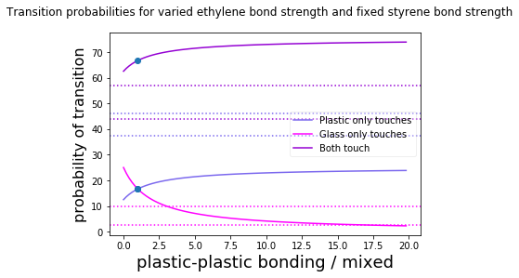
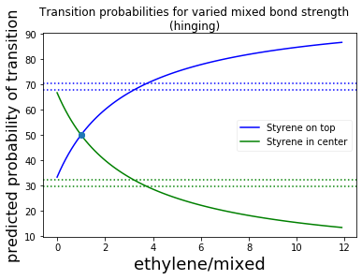
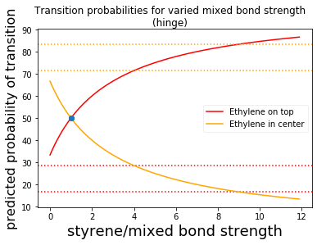
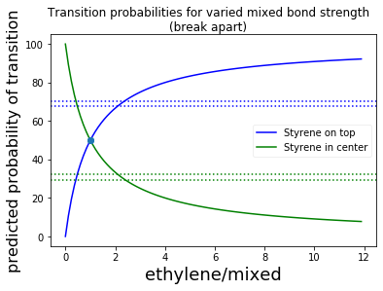
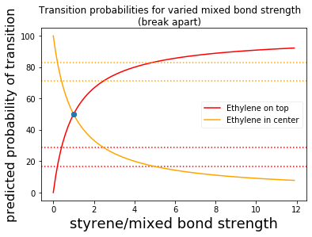
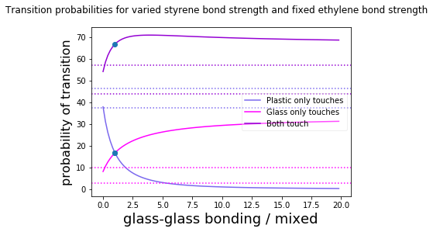
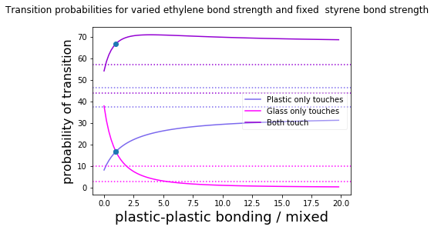
Results 1
Hinge vs Break apart model fits

Slide 17
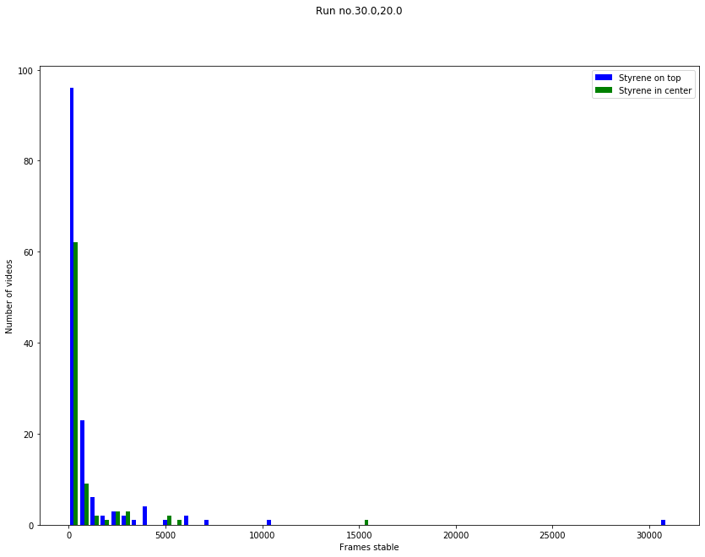
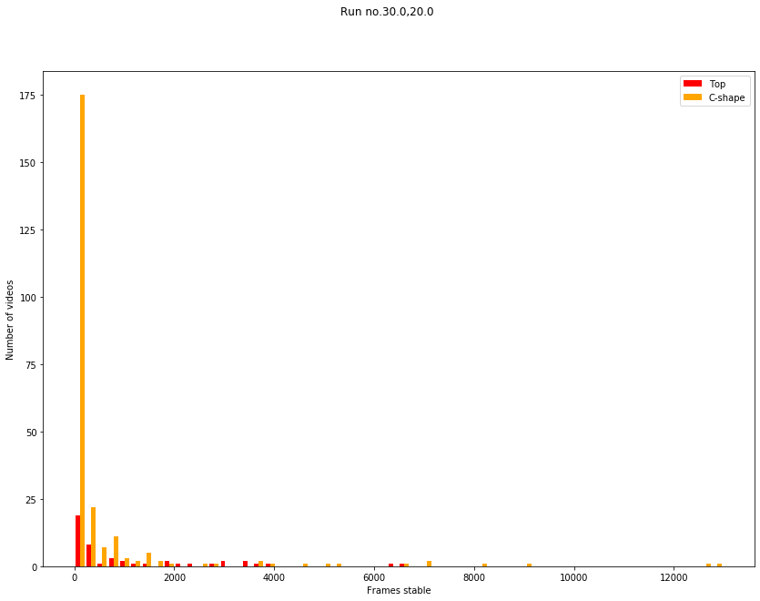
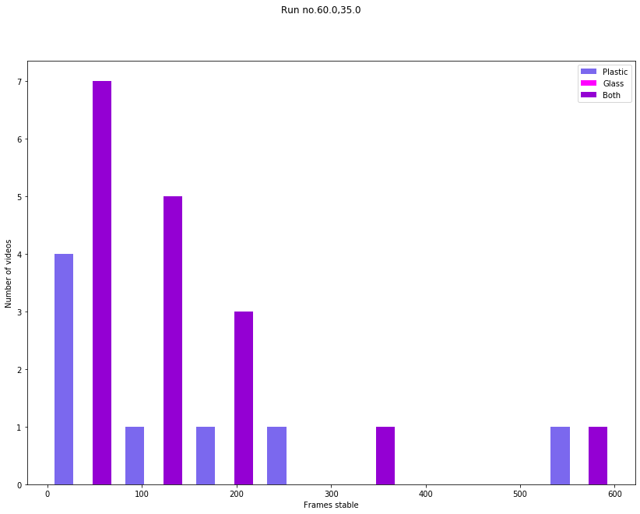
Results 1
Hinge vs Break apart model fits

Slide 18
Duplicating the strudty
Happened accidentally, and here’s what came of doing so
The three ethylene and three polystyrene experiments repated nicely, but the half of each experiment did not.
Show, by index, the two polystyrene and two ethylene majority experient runs
Show, by index, the two runs for half-hald
The half-jhalf runs show differenc ein one situation, and no difference in preferred state in the other.
So now we’re comparing the difference in the half half runs
The transition probs for the other tw aren’t’

Slide 19
So what are we studying now?
Whgy the difdference exists
Weigtht differences
Some sirface schmizzle

Slide 20
Why cjhhhange the syudy materials?
Say ti’s weight differences
So we change the weight
Thought we were going to match density better by using styrene, turns out we were already using styrene, so already close to matched
Sp use glass now; it’s much heavier
The polyethylene is the only hydrophobic one, and it stays the same from the previous experiment to this one
Material properties
Glass, polystyrene have different densities, so maybe glass wasn’t free to move about, or hit the glass slide more often
So use a kighter material, desity athed wit polystyrene

Slide 21
Results 2
No matter what, both models of motion predict that the state where both touch has the most configurations and should come first. That’s not the case though.

Slide 22
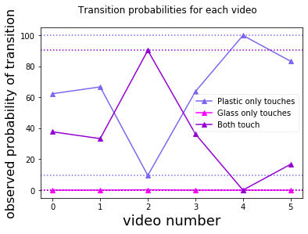
The preferred state to transition to fluctuates wildly per video
I observed only 2 transitions to a state where only the glass beads could touch (out of _00)

Slide 23
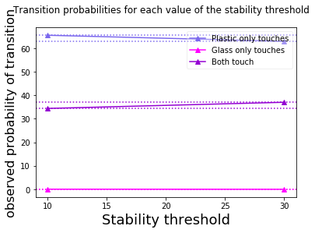
But when all videos are combined into one sequence of transitions, the plastic touching state is preferred, for the two values of stability threshold tried
So the videos where the plastic state is favoured must have more transitions (longer sequences / more sequences).

Slide 24
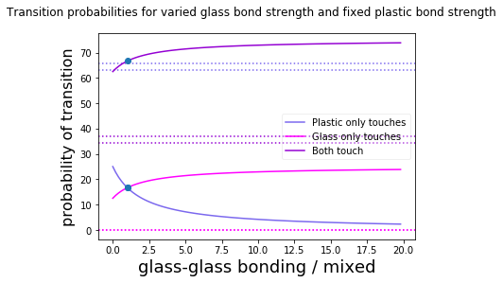
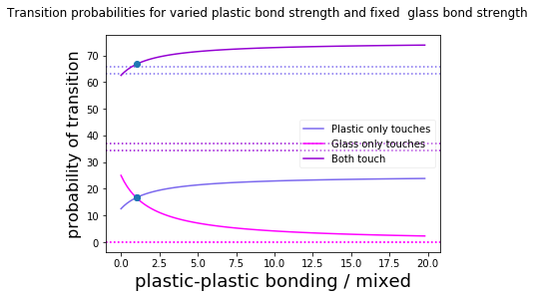
Here is what happens when the particles move with hinge motion, and the real data is the dashed lines. This clearly doesn’t fit reality. The unvaried bond strength ratio is held at 1.

Slide 25
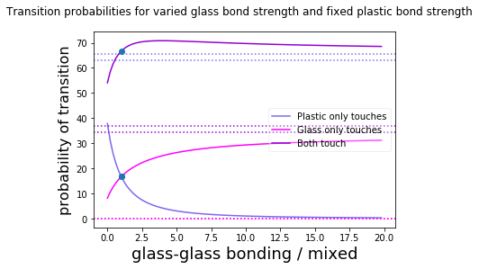
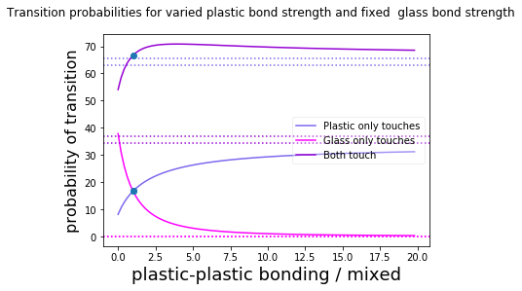
Here is what happens when the particles move with break apart motion. This clearly doesn’t fit reality. The unvaried bond strength ratio is held at 1.
The separation between the unfavoured states is wider in this model, but there’s still no way to get to the observed data, varying one bond strength alone.

Slide 26
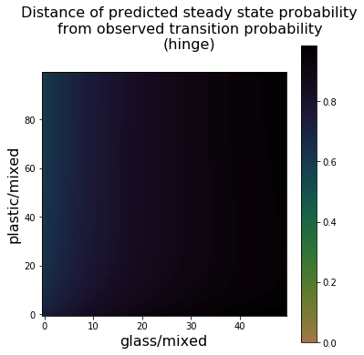
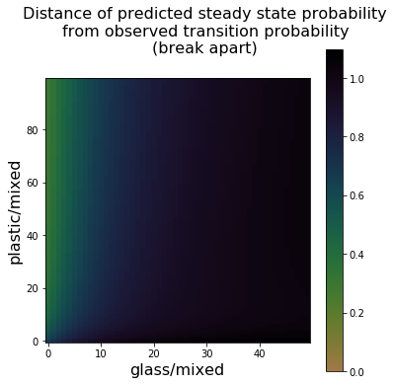
Here, the plot shows a range of glass and plastic bond strengths, and the distance of predictions to observed data. he distance between predicted percentages, as a vector: (pp,gp,bp) and observed percentages: (po,go,bo), is scaled by the length of the observed percentages vector and plotted for each value of glass and plastic bond strengths. If the difference is small, the area is green, or if it’s zero, yellow-brown. On the left is hinge motion, and on the right is break apart motion.
If we vary both the bond strength of the plastic connection and the glass connection, we still can’t match the data correctly, and we can’t really do it with the break apart motion either.

Slide 27
Glass vs styrene?

Slide 28
Pooling
That ends up making the half-half data indistinguishable almost from the glass data
The plastic dta is distinguishable

Slide 29
Factors affecting accuracy of this data
Not every transition is being counted
Diagonal and antidiagonal errors are a thing

Slide 30
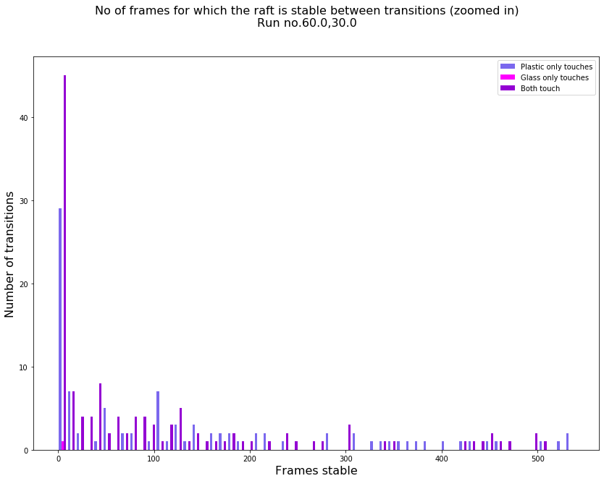
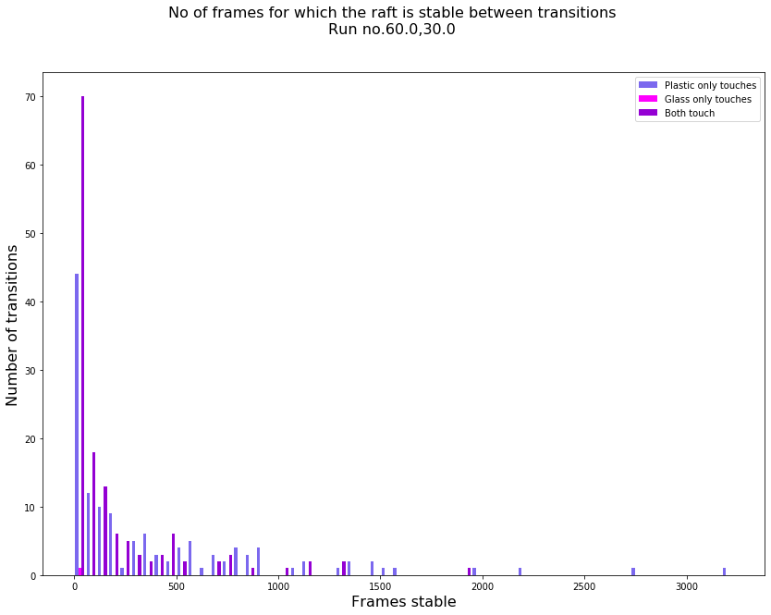
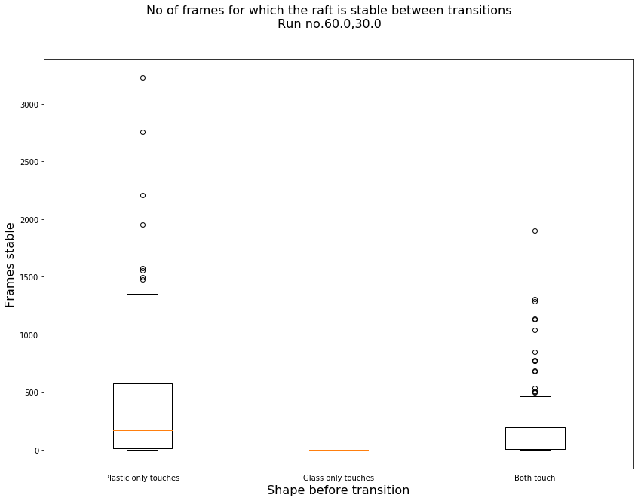
Not every transition is being counted
The transition times – time spent between transitions – bunch up on the side of short transitions

Slide 31
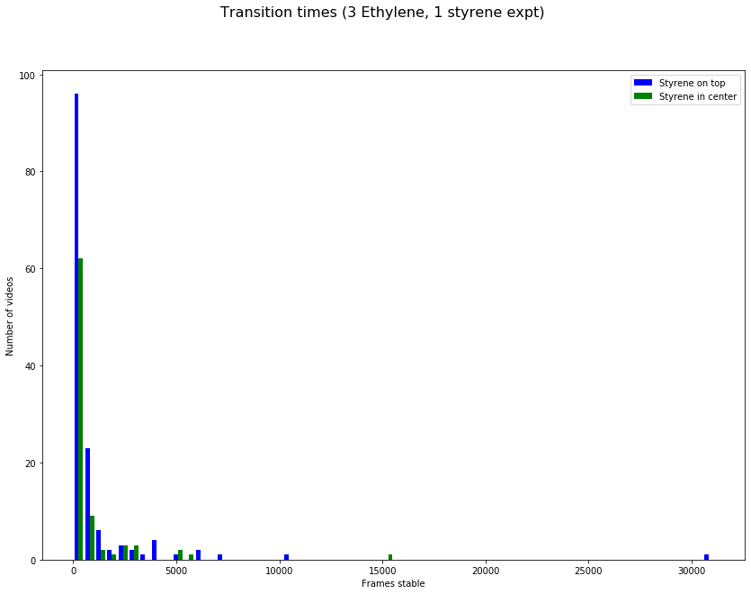
It’s the same with the styrene-ethylene experiments

Slide 32
If there is an average length of time, with very short and very long transitions around it, we’re missing the shorter ones
To solve this, if they’re from transitions between states, lower the stability threshold, to register transitions to and out of states which are briefly held.because some transitions are 0 frame sstable, there’s no time between the stable part f one state, and the stable part of the next state
If, on the other hand, for trnsitions only affecting the both state – which is elevated above the others in onl the short transition bins – the transition threshold could use lowering, since the zero frames of stability between the registration of frame and the registration of the same frame means there are trnasitions where the break apart lasts exactly as long as the current trasntio threshold, and so there are transitions whicha re even short, probably, and they are regarded.

Slide 33
Here is a plot showing the diagonal and antidiagonal erros that are possible with some threshold values

Slide 34
Software
List of software and what it does

Slide 35
Data
Experiments and their text files
Glass and Ethylene (latest): realhalfoutput.txt

Slide 36
Sddendum on thersholdsT 1 cotrols this. For instance, you can hav skipped states if its too low, anad diagonal errors if it’s too high
T2 controls that. You mostly get cuts of some kind of transitions if it’s too high, and not much problems if it’s too low unti l you get minor trouble mesing yo up

Slide 37
This is the chain of events in a classification (roughly)
Tree diagram goes here, in simplified form

